Slide 1
COMPARISON OF A 3D PRINTED PART USING PLA AND ABS MATERIALS
B. Vijay Kumar -18071A0304
B. Chandan -18071A0305
B. Bharath Chandra -18071A0306
Under the guidance of,
Dr. G. Srinivasa Gupta
Professor
Mechanical Engineering
Email ID:srinivasagupta_g@vnrvjiet.in

Slide 2
OUTLINE OF PRESENTATION
Abstract
Introduction
Literature Review
Design
Design Analysis
Cost Analysis
Result
Future Scope
References

Slide 3
Abstract
The problem we have identified is in the agriculture sector. For the farmers to sell the cotton and Mirchi in the government markets, cotton and Mirchi must be packed tightly in the gunny bags. The process of p acking Cotton and Mirchi in gunny bags is labor intensive, time taking and costly. Our solution is a semi-automated machine which produces a smaller shape and size packages, that reduces the cost and time, and makes it less labor intensive and also makes the transportation more economical by stacking multiple packages on a truck. The machine is powered by using the hydraulic pump of the tractor. The running cost of the Machine is 200 per hour. The estimated cost of the machine is 25000, which is affordable by the farmers. The machine uses hydraulic cylinders to compress the cotton and mirchi, and then packed into the bag.

Slide 4
Introduction
The objective of this project is to find a solution to the existing problem in the agriculture sector which is making it difficult for the farmers to attain profits. The problem we have identified is the painful and inefficient process of packing cotton and mirchi in the gunny bags by the farmers. The motivation for doing this project is the fact that the process of p- acking cotton and Mirchi into gunny bags is costly, time taking and a p hysically painful process. The process is easily automatable. From the survey it is observed that the cost of packing Mirchi of 25 tons is 7500 and time taken is 7 hours. And the process causes a lot of physical pain and burning sensation. By the presented solution the time is reduced to 1 hour, the cost is reduced to 3500, and the physical pain is reduced too. This increases the income to the farmer and makes cultivating the cotton and mirchi easy for the farmers.

Slide 5
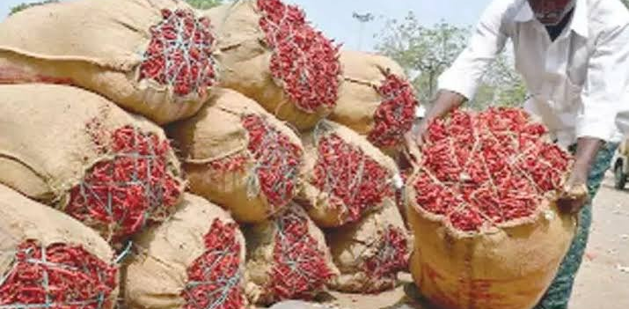
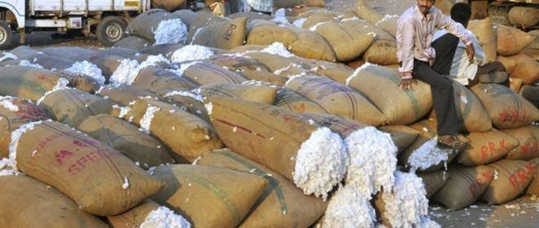
Introduction
1.5 Pain Points
1. Burning sensation on hands, legs, and nose.
2. Body pains. 3. Shortage of labor.
4. High Transportation and storage Costs.
5. Time taking
Mirchi Market Yard
Cotton Market Yard

Slide 6
Literature Review
A. G. Naik, et.al[1] - They have done research on the FEA implementation in analysis and optimization of top and bottom frame for hydraulic cotton lint baling press where from this paper we have learnt about FEA implementation for analysis and optimization of top and bottom frame for hydraulic cotton lint baling press. And ensured manufacturability is structurally optimized
Luigi Solazzi, et.al[2]– He clearly explained that the telescopic hydraulic cylinder is made up of composite material instead of steel geometry of the cylinder, and stress analysis at different positions of composite telescopic hydraulic cylinder and buckling analysis
S Baragetti,et.al[6]-This paper analyses the bending behavior of hydraulic piston-type actuators using analytical models, able to take into account friction, rectilinear imperfections and the actual geometric configuration of piston-type actuators. The reliability of these analytical models was confirmed by means of experimental tests carried out on full-scale equipment.

Slide 7
Design
Design Considerations
The following are the design requirements of the solutions, so that the present solution meets the requirements of farmers.
1. It has to be economically viable for the framer to use.
2. As most of the agriculture machines are powered and carried by tractor. So, the present solution has to work and be carried by the tractor.
3. It has to automate the harder compression process.

Slide 8
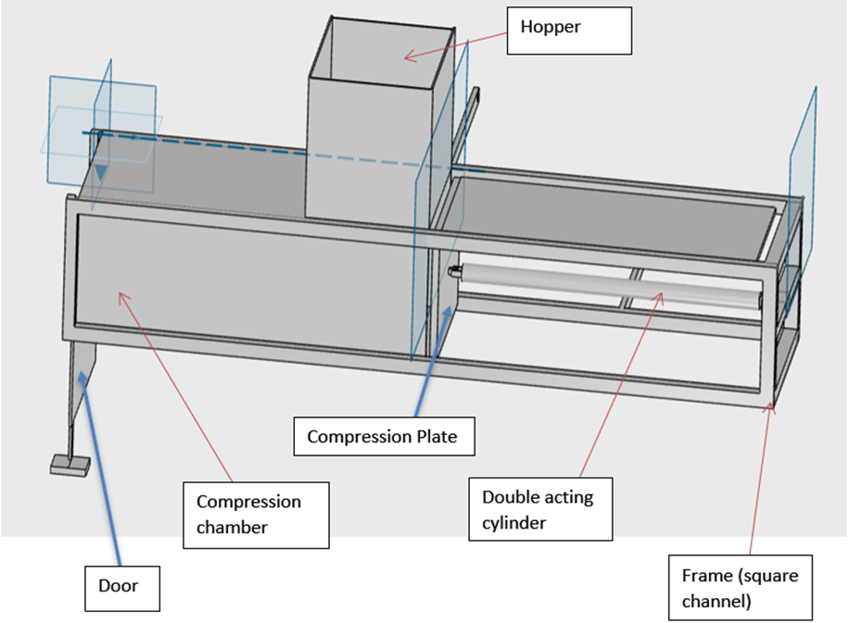
Design
Model-1
Problems with this design model are as follows
1. Length of the piston required is high.
2. Door mechanism is complex.
3. Commonly used gunny bags can’t be used while using this machine

Slide 9
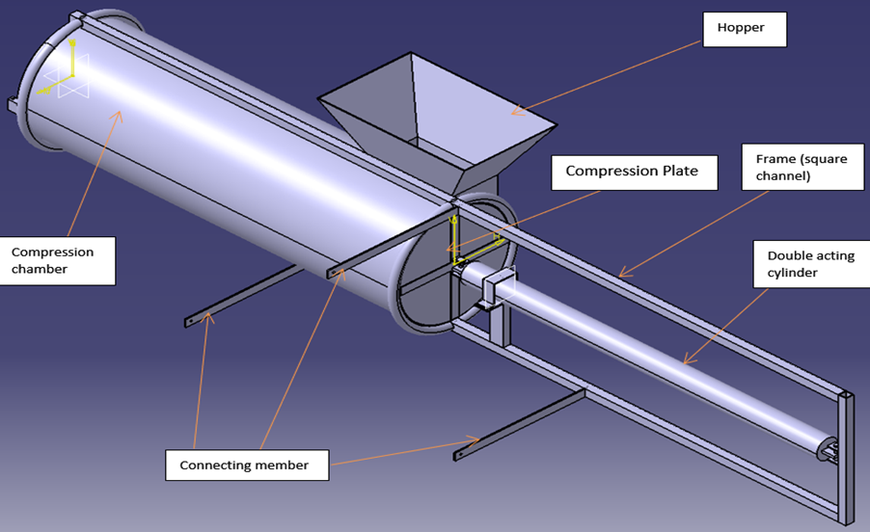
Design
Model-2
Problem with this design model are as follows
1. Length of the piston required is high.
2. Door mechanism is complex.

Slide 10
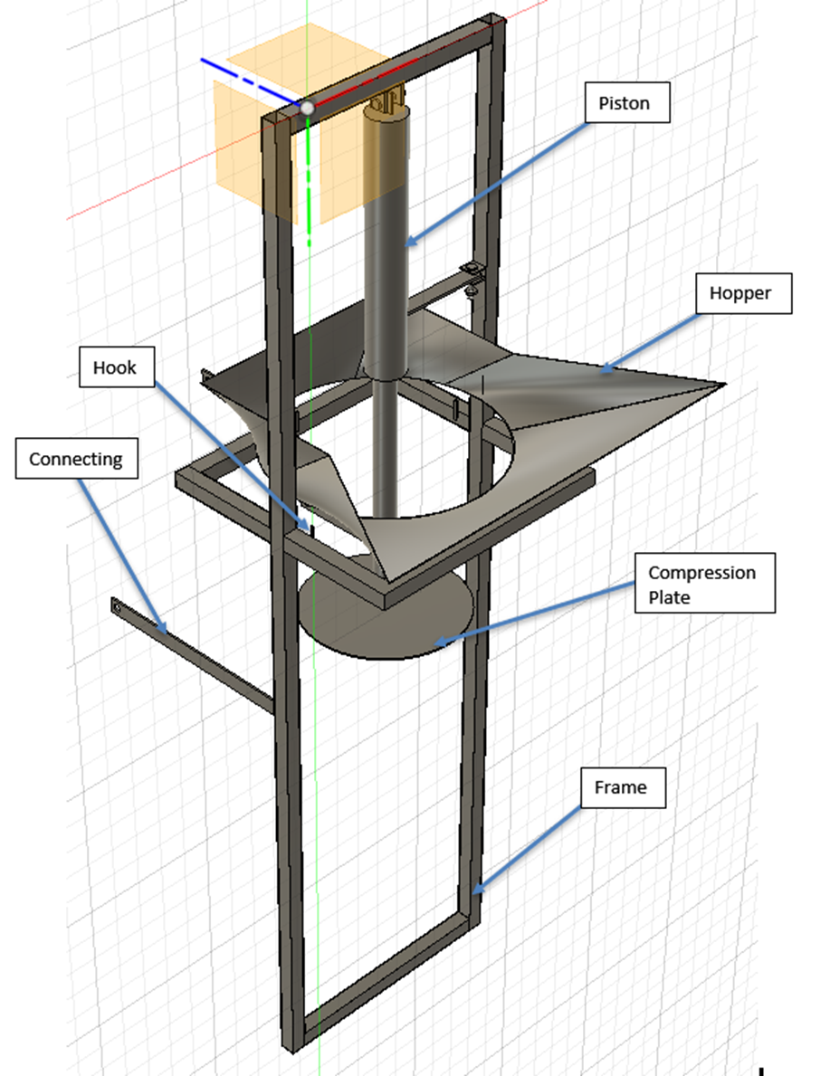
Design
Model-3
Advantages of this design are
1. Length of the piston is reduced.
2. There is no need for a compression chamber.
3. There is no need for any door mechanism.
4. This design is simpler and cost effective than the previous design.

Slide 11
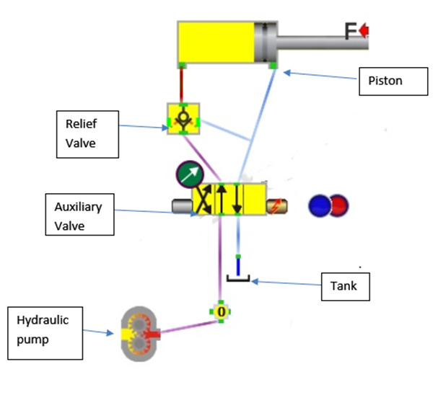
Design
Hydraulic circuit
Hydraulic circuit

Slide 12
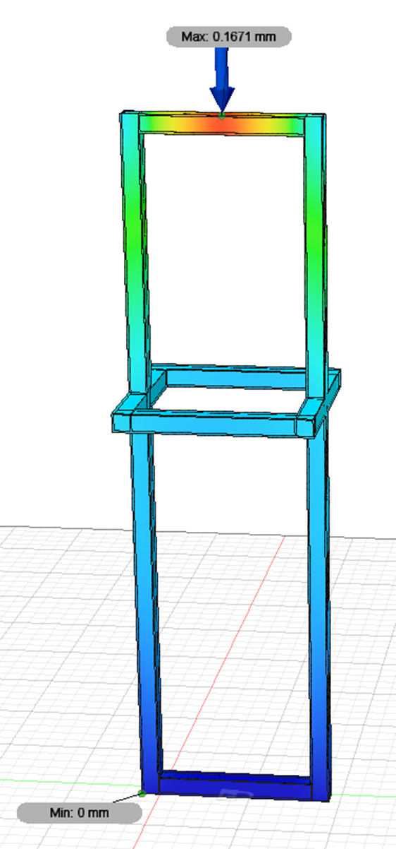
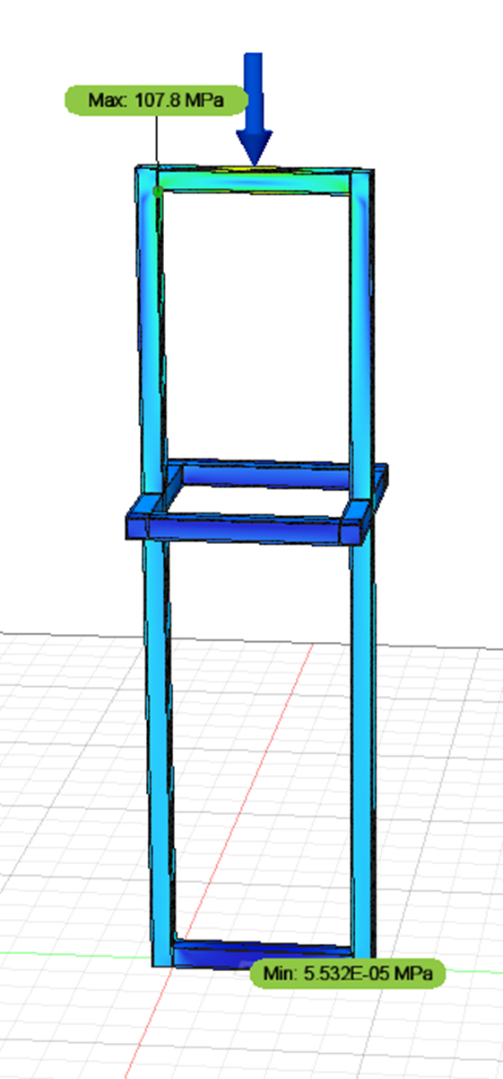
Anayalsis
Fusion 360 software has been used to analysis the strength of the frame of the machine.
Displacement Analysis
Stress Analysis

Slide 13
Cost Analysis
Components cost:
Double acting piston : 4000-6000/-
Pressure Relief Valve : 600-1000/-
Square channel: 588/-
Sheet metal required: 180/-
Pressure Relief Valve: 600-1000/-
So, the total price for the parts is 5428 – 7828/-
It has to be noted that this price is excluding the assembly cost.

Slide 14
Future scope
Future scope
Hydraulic compressor unit can be employed instead of tractor. This increases the price of the machine to 32000/-.
But the operation cost is reduced as electric power is cheaper than the diesel.

Slide 15
Result
Total price for the machine is around 5428 – 7828/-.
Table: Comparing the machine and human process.
 | Human | By machine
Time taken | 9 hours | 4.6 hours
Price | 7500/- | 3820/-
Number of people | 6 | 3
Number of Gunny bags | 70 | 46

Slide 16
References
Naik, A. G., and N. K. Mandavgade. "FEA Implementation In Analysis And Optimization Of Top And Bottom Frame For Hydraulic Cotton Lint Bailing Press." International Journal of Scientific & Engineering Research 3.7 (2012): 1-8.
Solazzi, Luigi, and Andrea Buffoli. "Telescopic hydraulic cylinder made of composite material." Applied Composite Materials 26.4 (2019): 1189-1206.
Din AT, Rahimi RA, Kadir MA. A numerical analysis on double acting pneumatic telescopic cylinder motion characteristics. In2010 2nd International Conference on Computer Engineering and Technology 2010 Apr 16 (Vol. 5, pp. V5-71). IEEE.
Sattar Ramazanovich, and Olim Kholikulovich Eshkobilov. "Analysis of the Conditions of Cotton Packing in Containers with Flexible Casing." Revista Geintec-gestao Inovacao E Tecnologias 11, no. 2 (2021): 871-882.
Food Corporation of India “Guidelines for inspection of jute gunny bales” 2018.
Baragetti, Sergio, and A. Terranova. "Bending behaviour of double-acting hydraulic actuators." Proceedings of the Institution of Mechanical Engineers, Part C: Journal of Mechanical Engineering Science 215, no. 5 (2001): 607-619.
Boye, T., O. Adeyemi, and E. Emagbetere. "Design and finite element analysis of double-acting, double-ends hydraulic cylinder for industrial automation application." Am. J. Eng. Res 6 (2017): 131-138.
Husin, Nur Azuan Bin. "Impact of Seed Cotton Compression on Cottonseed Quality." PhD diss., 2016.
Mariyappagoudar, Satish B., and Vishal S. Patil. "Design and Analysis of Hydraulic Press using ANSYS." IJIRST–International Journal for Innovative Research in Science & Technology 3, no. 07 (2016).

Slide 17


